Slide 1
Diagnostic modalities for sickle cell disease in India - New technologies and recent advances
Dr. Heena Tabassum
Program Officer and Scientist
Indian Council of Medical Research-Headquarters
New Delhi

Slide 2
Introduction
Early diagnosis of sickle cell disease (SCD) for
Timely intervention
Preventing complications like pain crises, infections, and organ damage.
Reducing childhood mortality
Enhancing quality of life

Slide 3
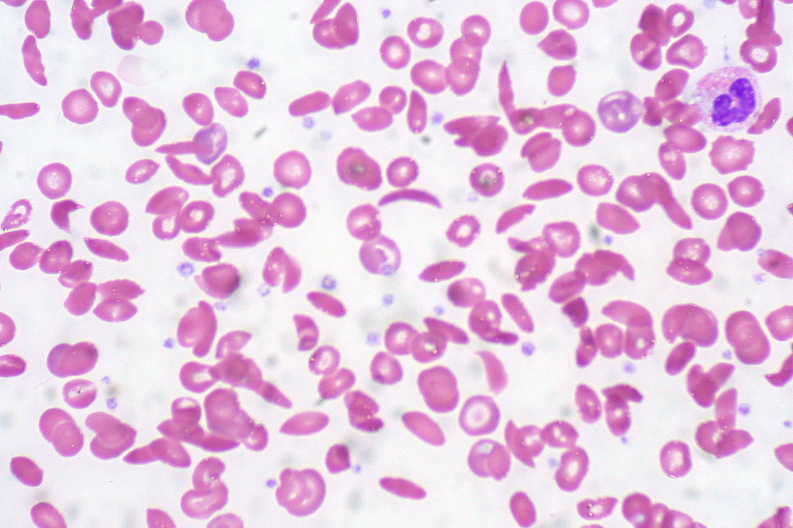
Introduction (cont.)
Screening/diagnosis of SCD can be done at
Prenatal/antenatal
Newborn
Population-based
Diagnostic tests can be
Conventional, advanced, emerging, or point of care (POC)
Used for screening or confirmatory
This Photo by Unknown Author is licensed under CC BY

Slide 4
Diagnostic tests can be used for screening or confirmatory
Confirmatory test
Screening
To avoid false negatives and false positives, confirmatory tests are performed.
Can be based on HPLC or DNA Analysis
Essential to rule out other hemoglobinopathies and ensure proper management.
Results inform treatment plans, including potential interventions like hydroxyurea or blood transfusions.
To find carriers of sickle cell trait or disease.
Screening can be done at birth or at any point in a person's life.
Screening programs implemented in high prevalence areas
e.g., Solubility test, peripheral blood smear, Hemoglobin electrophoresis, and HPLC.

Slide 5
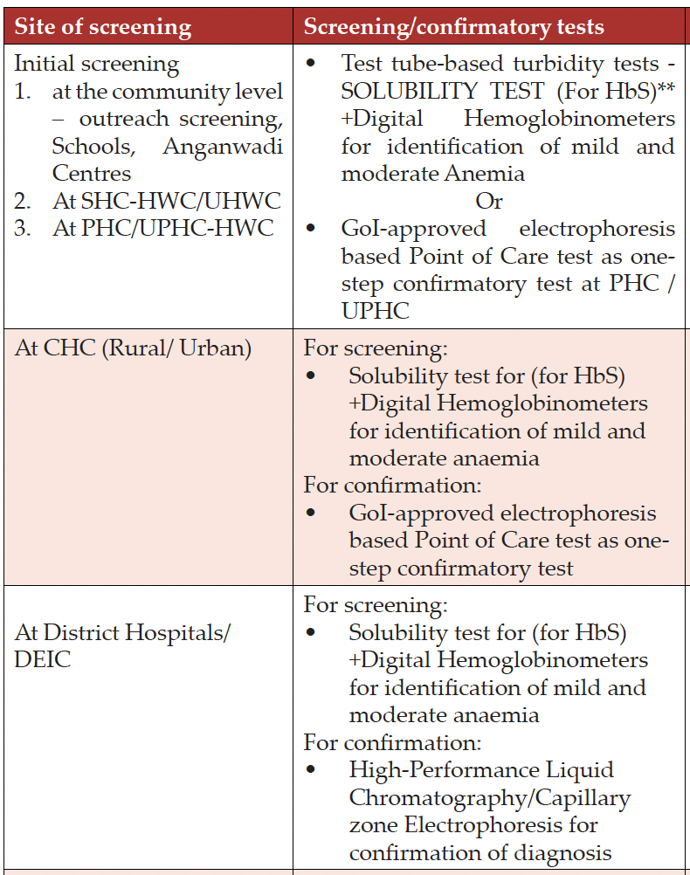
Screening approach:
Option 1: One-step approach - POC confirmatory test approved by Govt. of India.
Option 2: Two-step approach - Mass screening / Initial screening using Solubility test then confirmation using POC confirmatory test or HPLC / Electrophoresis
National Sickle Cell Elimination Mission 2023, Ministry of Health and Family Welfare Government of India

Slide 6
Prenatal/ANC testing
Amniocentesis
Samples amniotic fluid for genetic testing, chromosomal abnormalities, and other conditions.
Pros:
Enables early identification of SCD in the fetus.
Cons:
Invasive procedures with risks of miscarriage and infection
Time-consuming
Widely used and well-studied procedure.
Typically performed later in pregnancy (>15 weeks).
Source: https://my.clevelandclinic.org/health/diagnostics/4206-genetic-amniocentesis
Notes:
During amniocentesis, guided by an ultrasound, a thin needle is inserted to remove a small amount of amniotic fluid from the sac surrounding the fetus and the collected fluid is then tested.

Slide 7
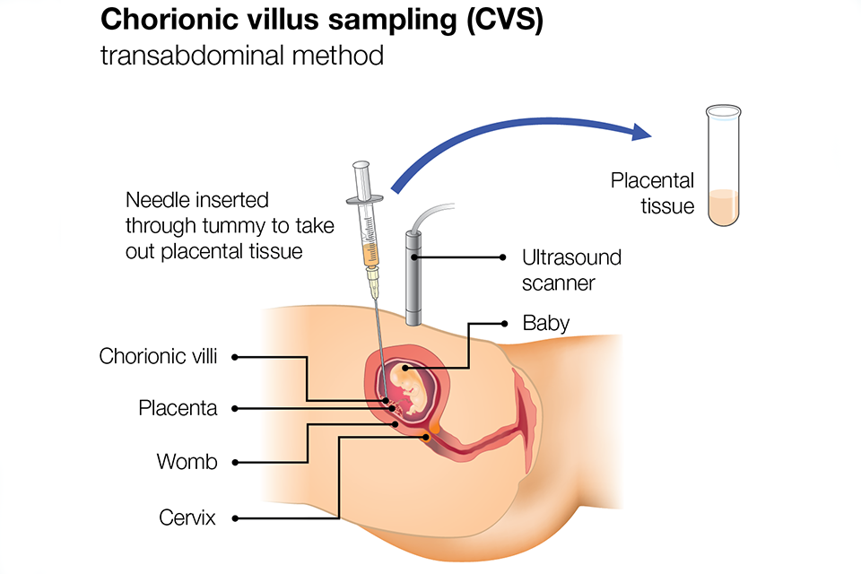
Prenatal/ANC testing
Chorionic Villus Sampling
Sample of chorionic villi(placenta) taken either through the cervix or abdomen for genetic disorders and hemoglobin genotype.
Pros:
Can be performed earlier in pregnancy (11-14 weeks)
Cons:
Slightly higher risk of miscarriage compared to amniocentesis.
Provides faster results than amniocentesis.
Tests placental tissue, which is genetically similar to the fetus
May not provide as comprehensive information as amniocentesis
Invasive procedure
Can be transabdominal or transcervical
Source: Public Health England, Screening in pregnancy: CVS and amniocentesis information for parents
Notes:
CVS is usually done from weeks 11 to 14 weeks of pregnancy but can be done later depending on the position of the placenta.
CVS can be performed:
through the abdomen – transabdominal
through the cervix – transcervical
The procedure involves applying a gel to the skin, moving an ultrasound over the belly, and removing a small sample of cells from the placenta.

Slide 8
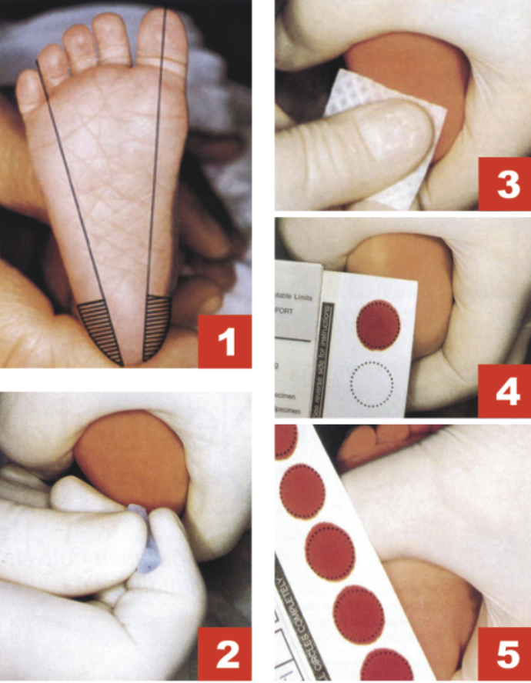
Newborn screening (NBS)
Identify infants early before symptoms appear.
NBS typically involves a heel prick test to determine the presence of abnormal Hb
If screening test indicates presence of abnormal Hb, confirmatory test is performed
High-performance liquid chromatography (HPLC), capillary electrophoresis (CE) and isoelectric focusing (IEF)
Conducted as a part of population-based healthcare programs

Slide 9
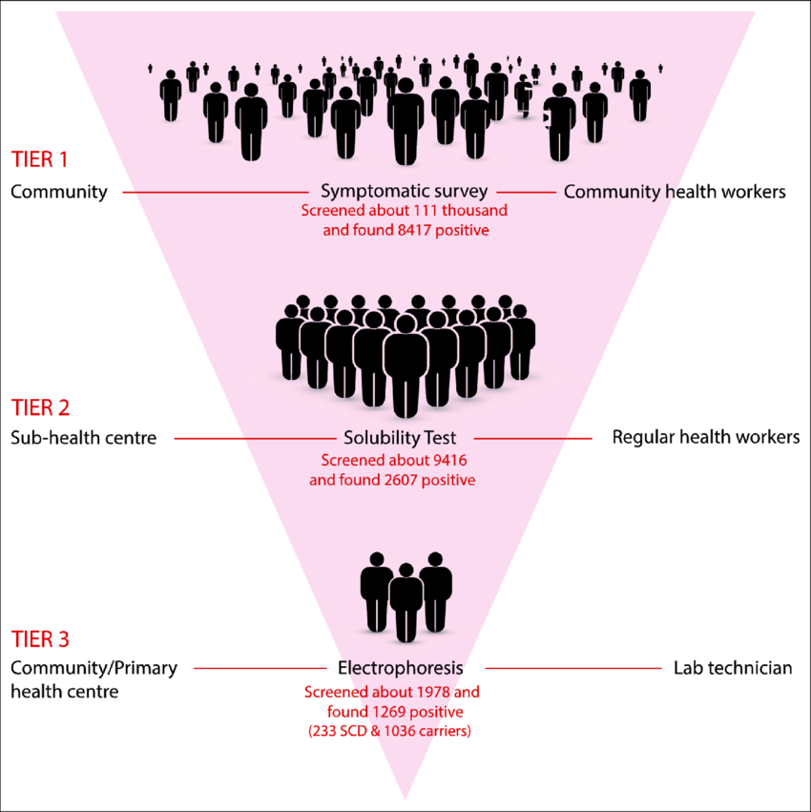
Population-based screening
Screening initiatives aim to identify carriers in populations with high SCD prevalence.
Electrophoresis/Molecular Testing/POCs
Pros:
Can guide public health interventions and educational campaigns.
Early identification of at-risk individuals can reduce morbidity/Mortality.
Cons:
Potential of False Negatives/Positives mandates confirmatory testing
Resource-intensive; may not be feasible in all regions.
Babu, B. V., Sharma, Y., Sridevi, P., Surti, S. B., Ranjit, M., Bhat, D., ... & Sudhakar, G. (2023). Feasibility of population-based screening of sickle cell disease through the primary health care system in tribal areas of India. Journal of Medical Screening, 30(1), 28-35.

Slide 10
Conventional diagnostics tests
Screening tests
Sickling tests
Solubility test
Full blood count
Peripheral blood film
Hemoglobin electrophoresis
Solubility Test or Sickling Test checks for presence of HbS by exposing red blood cells to a deoxygenating agent.
A peripheral blood smear involves examining a blood sample under a microscope for the characteristic sickle-shaped RBCs.
Full blood count looks for anemia, hemolysis, and compensatory bone marrow activity.
Hb electrophoresis is the gold standard. Differentiates types of Hb based on their electrical charge.

Slide 11
Complete blood count
Measures hemoglobin levels, hematocrit, red blood cell count, white blood cell count, and platelet count.
Used in NBS and population screening
Provides initial indicators of anemia.
Pros:
Widely available in clinical settings
Provides quick results.
Cons:
Limited specificity; abnormal results can indicate various hematological disorders.
Cannot distinguish between different types of hemoglobinopathies.

Slide 12
Sickling/solubility test
Solubility tests assess the presence of HbS in the blood.
Used for population-based screening.
A sample is mixed with a solution that lyses red blood cells, allowing hemoglobin to dissolve.
Pros:
Rapid and cost-effective.
Simple procedure that can be performed in outpatient settings.
Cons:
Cannot differentiate between HbS and other hemoglobin variants
False positives may occur in cases of high fetal HbF levels.

Slide 13
Peripheral blood film
The slide is examined for RBC morphology, WBC differential count, & Platelet count & morphology.
Used for prenatal, NBS & population screening.
Pros:
Can be performed quickly in the lab, providing timely information for diagnosis.
Cons:
Interpretation can be subjective.
Does not provide detailed information on cellular function or genetic abnormalities.
Accurate interpretation requires trained personnel with expertise in hematology.

Slide 14
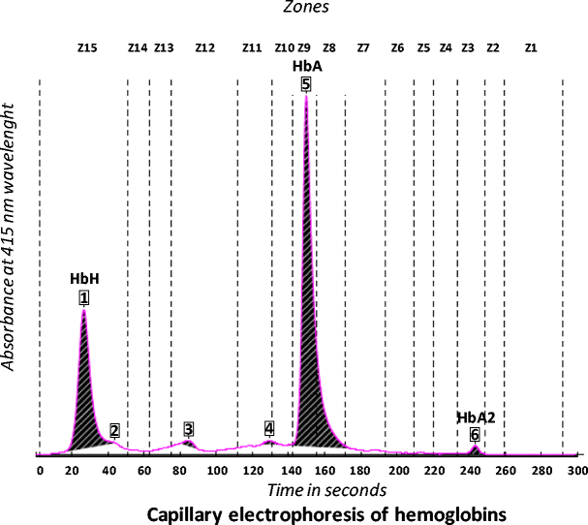
Hemoglobin electrophoresis
Differentiates types of Hb based on their electrical charge, allowing for identification and quantification.
Used for newborn and population screening
Types:
Alkaline electrophoresis: blood sample prepared as a hemolysate and then passed through electric field in an alkaline medium
Capillary electrophoresis: electric current is applied to a silica capillary to separate Hb types
Cellular electrophoresis: A cellulose acetate strip is used to separate Hb molecules based on their charge
Pros:
Highly effective for diagnosing specific hemoglobinopathies
Can quantify the percentages of different hemoglobin types
Results are based on measurable parameters, reducing subjective interpretation.
Cons:
time-consuming and expensive
requires specialized laboratory equipment.

Slide 15
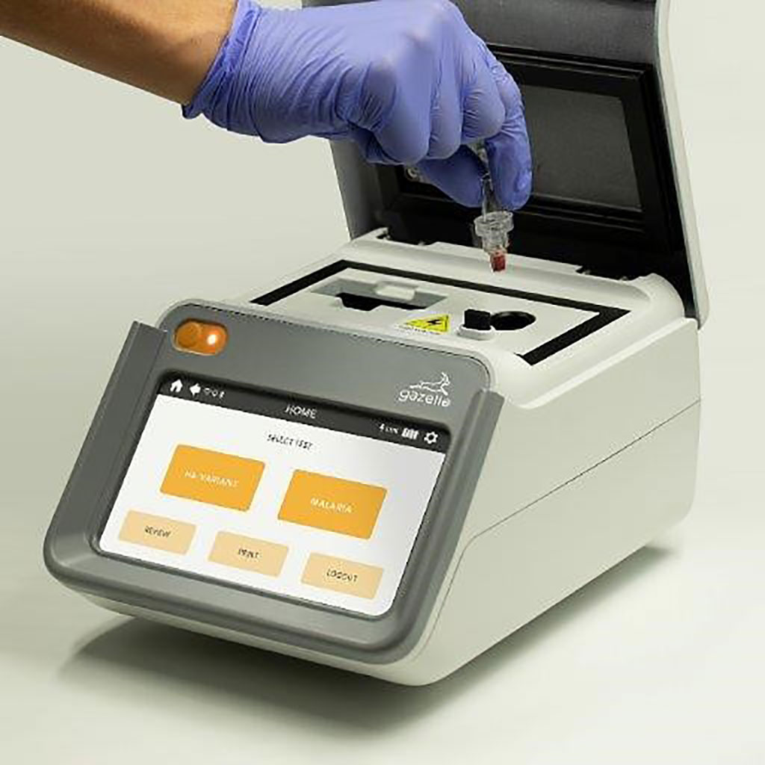
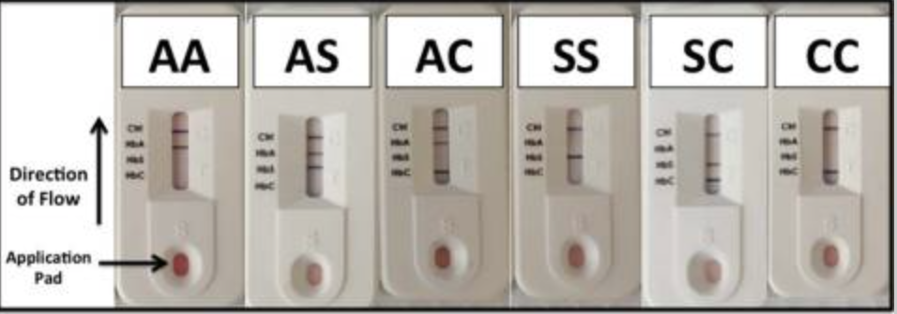
Point-of-Care (POC) tests
Any tests performed at or near a patient and at the site where care or treatment is provided.
Quick, affordable, and reliable diagnostic tools for SCD.
Uses Lateral flow technology, Immunoassay, or Molecular POC.
Source: Hemex Health
McGann, P. T., Schaefer, B. A., Paniagua, M., Howard, T. A., & Ware, R. E. (2016). Characteristics of a rapid, point-of-care lateral flow immunoassay for the diagnosis of sickle cell disease. American journal of hematology, 91(2), 205–210. https://doi.org/10.1002/ajh.24232

Slide 16
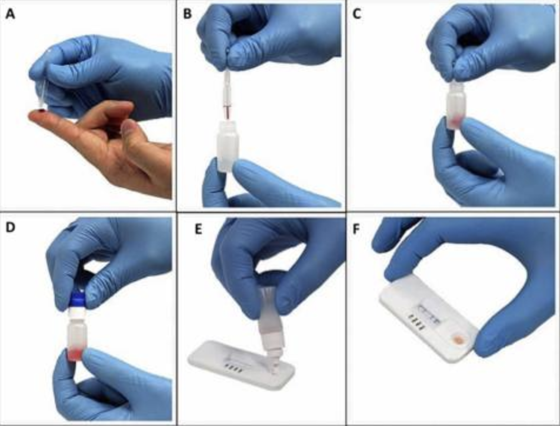
Lateral Lateral flow immunoassay (LFIA)
LFIA uses antibodies to detect the presence of hemoglobin variants in blood.
Sandwich format uses polyclonal antibodies to capture hemoglobin variants, and a monoclonal antibody to capture hemoglobin alpha.
Competitive format uses monoclonal antibodies to capture hemoglobin variants and a reagent antigen that competes with the sample antigen to bind to the antibodies.
Detects hemoglobin variants (HbS, HbC, HbE, etc.) in blood samples
Results available within minutes (typically 5-20 minutes)
High sensitivity and specificity
Weakness:
qualitative nature /poor inter-observer reproducibility
McGann, P. T., Schaefer, B. A., Paniagua, M., Howard, T. A., & Ware, R. E. (2016). Characteristics of a rapid, point-of-care lateral flow immunoassay for the diagnosis of sickle cell disease. American journal of hematology, 91(2), 205–210. https://doi.org/10.1002/ajh.24232

Slide 17
POCs for prenatal testing, newborn, and population screening in high-risk and resource‐limited settings
ICMR advises use of Confirmatory tests for LFIA positive results
List of SCD In vitro Diagnostic Tests recommended is available: https://www.icmr.gov.in/reports

Slide 18
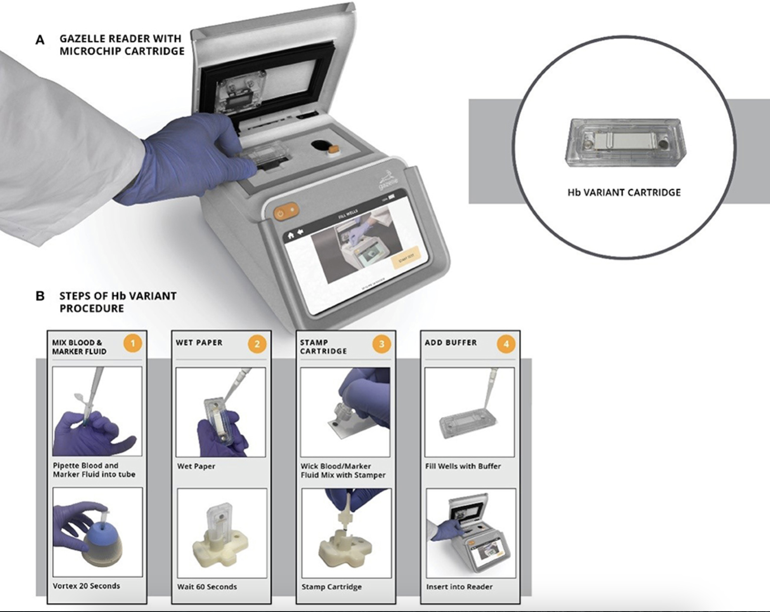
Gazelle
Portable microchip electrophoresis platform
includes a reader and cellulose acetate cartridge.
identify the most common hemoglobin variants in low-resource settings.
Easy to use and provides quick, accurate results.
Quick turnaround times and low-cost
Perform widespread screening affordably
High sensitivity and specificity in detection SCD and SCD trait
Can produce false positives for beta-thalassemia
Shrivas, S., Patel, M., Kumar, R., Gwal, A., Uikey, R., Tiwari, S. K., ... & Shanmugam, R. (2021). Evaluation of microchip-based point-of-care device “Gazelle” for diagnosis of sickle cell disease in India. Frontiers in Medicine, 8, 639208.

Slide 19
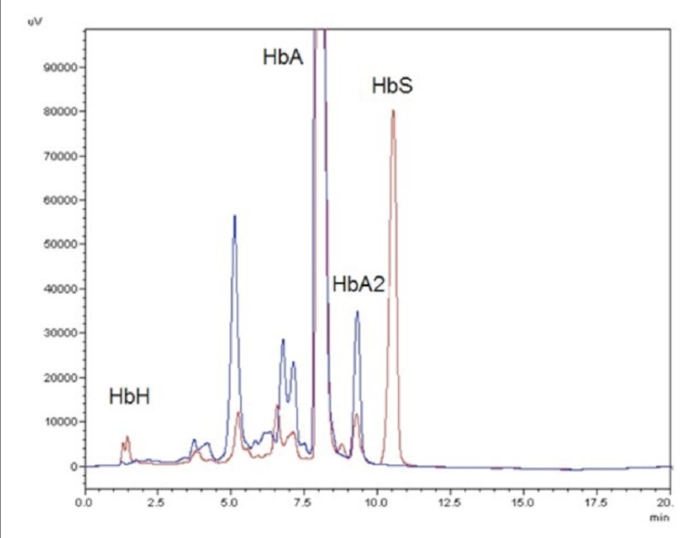
Advanced diagnostic tests for SCD
High Performance Liquid Chromatography (HPLC)
HPLC separates components in a mixture based on their interaction with a stationary phase and a mobile phase, allowing for quantitative analysis.
Used for NBS and population screening
Pros:
Provides precise separation and quantification of compounds.
Can analyze a wide range of substance
Can be automated for high-throughput analysis.
Cons:
Expensive equipment and maintenance.
Method development can be complicated and time-consuming.
Users need training to operate the equipment and interpret results.
High-performance liquid chromatography pattern of Hemoglobin H (HbH) disease (Medinger et al. 2011)

Slide 20
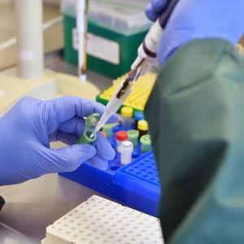
Polymerase Chain Reaction (PCR)
PCR amplifies a fragment of the β-hemoglobin gene.
A 517 bp fragment detects the normal gene, while a 267 bp fragment detects the mutant allele.
Pros:
Can be used for prenatal, newborn & population
Can detect tiny amounts of DNA.
Results can be obtained within a few hours.
Cons:
High sensitivity can lead to false positives from contamination.
Requires specialized thermal cyclers and reagents.
Primer design is crucial; poor design can lead to non-specific amplification.

Slide 21
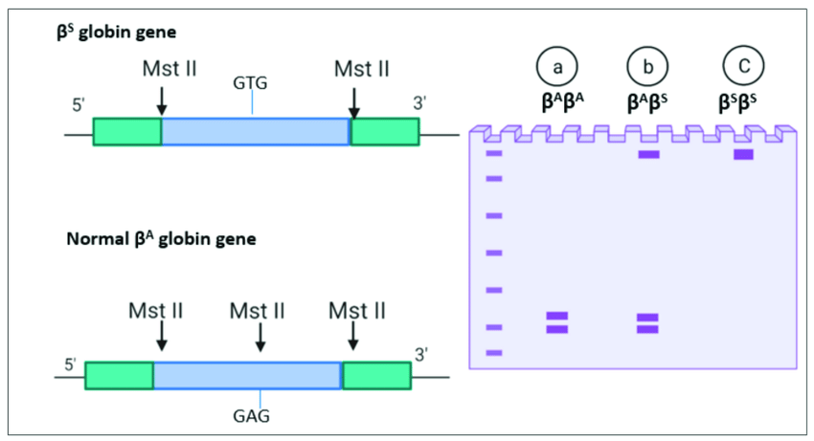
Restricted Fragment Length Polymorphism (RFLP)
DNA is digested with restriction enzymes, creating fragments of varying lengths separated by gel electrophoresis.
A single-nucleotide polymorphism in the second position of the sixth codon of the beta-globin gene. The absence of the MstII site is a genetic marker for SCD.
Pros:
Can be used for prenatal, newborn & population
Useful for identifying genetic polymorphisms and mutations.
Well-established with clear protocols in many labs.
Cost-Effective
Cons:
Time-Consuming.
May not detect small variations in DNA sequences.
Requires careful handling and interpretation of gels.

Slide 22
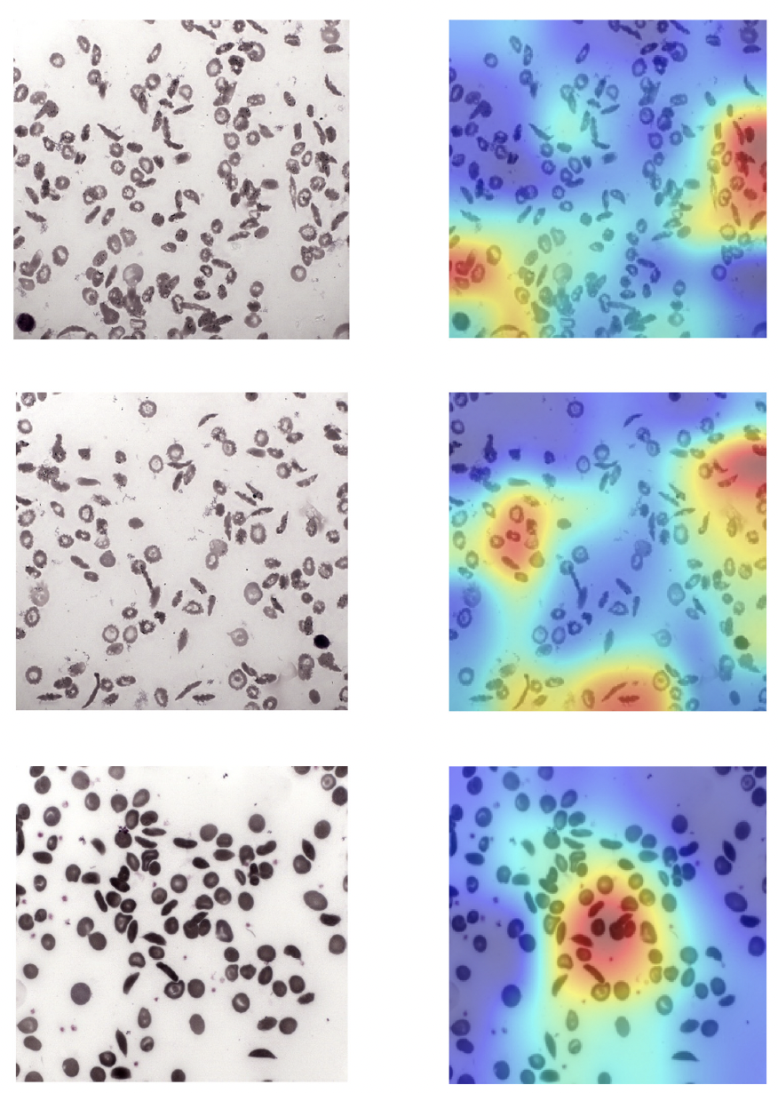
Emerging Techniques
Smartphone-based POC tests
Involves a smartphone attachment equipped with optical components and magnets to utilize differences in RBC density.
The smartphone camera captures images of the sample, providing a portable and user-friendly diagnostic tool
e.g., Detection of sickle cell disease using deep neural networks
Deep learning technique to detect the presence of sickle cells in a blood smear and classify them using three different networks:
GoogLeNet, ResNet18, and ResNet50
ResNet50 gave the highest accuracy of 94.90%
Kawooya, I., Kayongo, E., Munube, D., Mijumbi-Deve, R., Elliott, S., Vandermeer, B., & Sewankambo, N. (2022). Point‐of‐care diagnostic tests for sickle cell disease. The Cochrane Database of Systematic Reviews, 2022(9).
Goswami, N., Goswami, A., Sampathila, N., Bairy, M., Chadaga, K. & Belurkar, S. (2024). Detection of sickle cell disease using deep neural networks and explainable artificial intelligence. Journal of Intelligent Systems, 33(1), 20230179. https://doi.org/10.1515/jisys-2023-0179

Slide 23
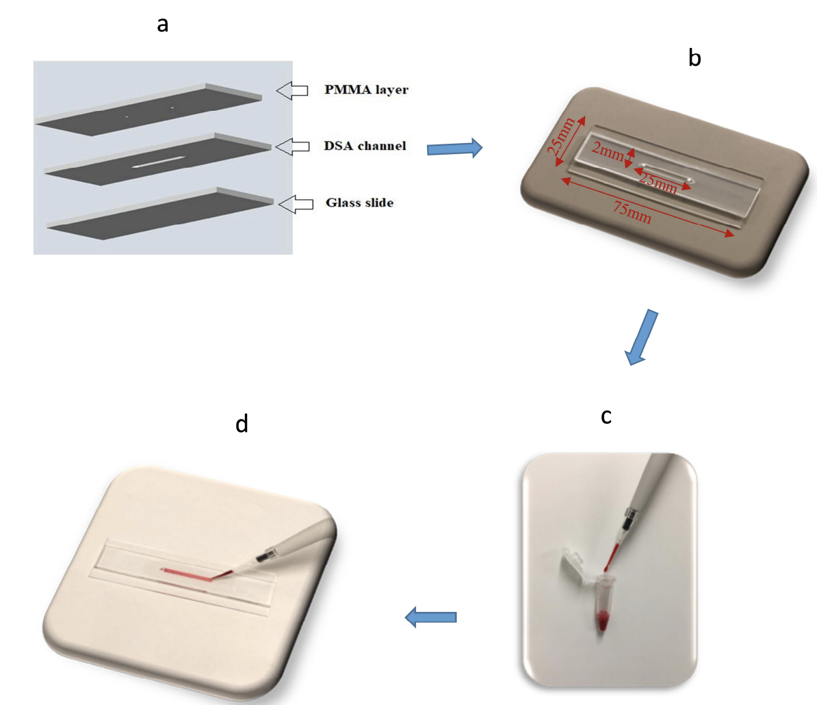
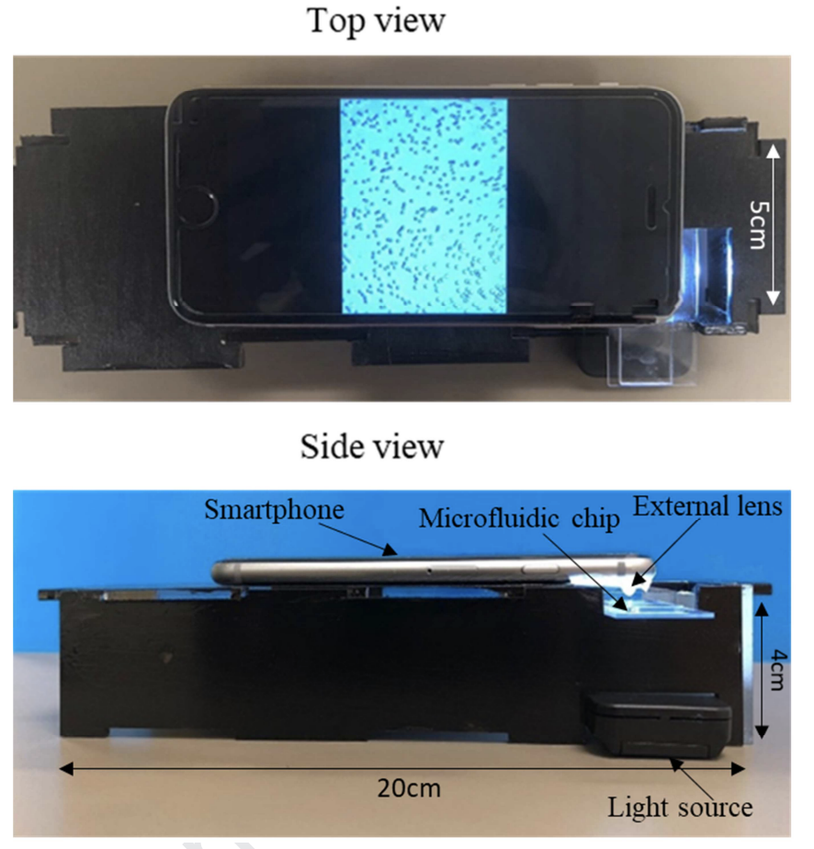
Smartphone-based image acquisition method for capturing RBC images from SCD patients in normoxia and hypoxia conditions.
Utilizes computer algorithm to differentiate RBCs from the patient’s blood before and after cell sickling.
Indian Manufacturer’s are also developing this technology

Slide 24
Problems in identifying sickle cells and artificial intelligence (AI) as an aid
Shape and size variability: Sickle cells can take on various shapes and sizes, making them difficult to differentiate from other red blood cells. The orientations also need to be considered while analysing.
Low concentration: Sickle cells are found in low numbers in the blood, making detection challenging.
Morphological variations: The form and appearance of sickle cells can alter over time, making identification complicated.
Human error: Because sickle cell identification is frequently done manually by experienced professionals, it is vulnerable to human error and unpredictability.
Lack of automation: Current methods for identifying sickle cells are time-consuming and labour-intensive, and automated solutions are needed to improve efficiency and accuracy.

Slide 25
Challenges and Limitations
Accessibility of diagnostic facilities, particularly in rural India.
High costs associated with advanced genetic testing. Calls for “Make in India” technologies.
Training healthcare providers in new diagnostic technologies for effective implementation.
Public awareness campaigns to encourage screening in high-risk populations.
Importance of a multi-faceted approach to SCD diagnosis.

Slide 26
References
Rao, P., Raj, E. A., Natesan, S., & Gudi, N. (2024). Prevalence of Sickle cell disease, Sickle cell Trait and HBS-beta-thalassemia in India: a systematic review and Meta-analysis. Clinical Epidemiology and Global Health, 101678.
McGann, P. T., Schaefer, B. A., Paniagua, M., Howard, T. A., & Ware, R. E. (2016). Characteristics of a rapid, point‐of‐care lateral flow immunoassay for the diagnosis of sickle cell disease. American journal of hematology, 91(2), 205-210.
Goswami, N., Goswami, A., Sampathila, N., Bairy, M., Chadaga, K. & Belurkar, S. (2024). Detection of sickle cell disease using deep neural networks and explainable artificial intelligence. Journal of Intelligent Systems, 33(1), 20230179. https://doi.org/10.1515/jisys-2023-0179
Medinger, M., Saller, E., Harteveld, C. L., Lehmann, T., Graf, L., Rovo, A., ... & Tichelli, A. (2011). A rare case of coinheritance of Hemoglobin H disease and sickle cell trait combined with severe iron deficiency. Hematology reports, 3(3), e30.
National Sickle Cell Elimination Mission (2023). Guidelines for national programme for prevention & management of sickle cell disease.https://sickle.nhm.gov.in/uploads/english/OperationalGuidelines.pdf
Okwi, A. L., Byarugaba, W., Parkes, A., & Ocaido, M. (2010). The reliability of sickling and solubility tests and peripheral blood film method for sickle cell disease screening at district health centers in Uganda. Clinics in Mother and Child Health, 7(1).
Babu, B. V., Sharma, Y., Sridevi, P., Surti, S. B., Ranjit, M., Bhat, D., ... & Sudhakar, G. (2023). Feasibility of population-based screening of sickle cell disease through the primary health care system in tribal areas of India. Journal of Medical Screening, 30(1), 28-35.
Shrivas, S., Patel, M., Kumar, R., Gwal, A., Uikey, R., Tiwari, S. K., ... & Shanmugam, R. (2021). Evaluation of microchip-based point-of-care device “Gazelle” for diagnosis of sickle cell disease in India. Frontiers in Medicine, 8, 639208.
McGann, P. T., Schaefer, B. A., Paniagua, M., Howard, T. A., & Ware, R. E. (2016). Characteristics of a rapid, point-of-care lateral flow immunoassay for the diagnosis of sickle cell disease. American journal of hematology, 91(2), 205–210. https://doi.org/10.1002/ajh.24232
National Sickle Cell Elimination Mission (2023). Training modules for Medical officers.

Slide 27
THANK YOU

